Slide 1
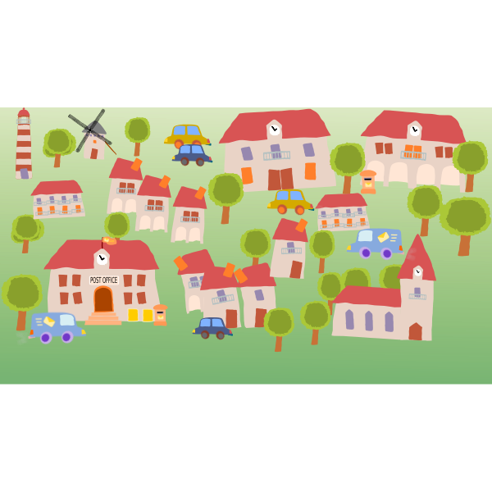

Curriculum Design
Nantlwys Federation

Slide 2
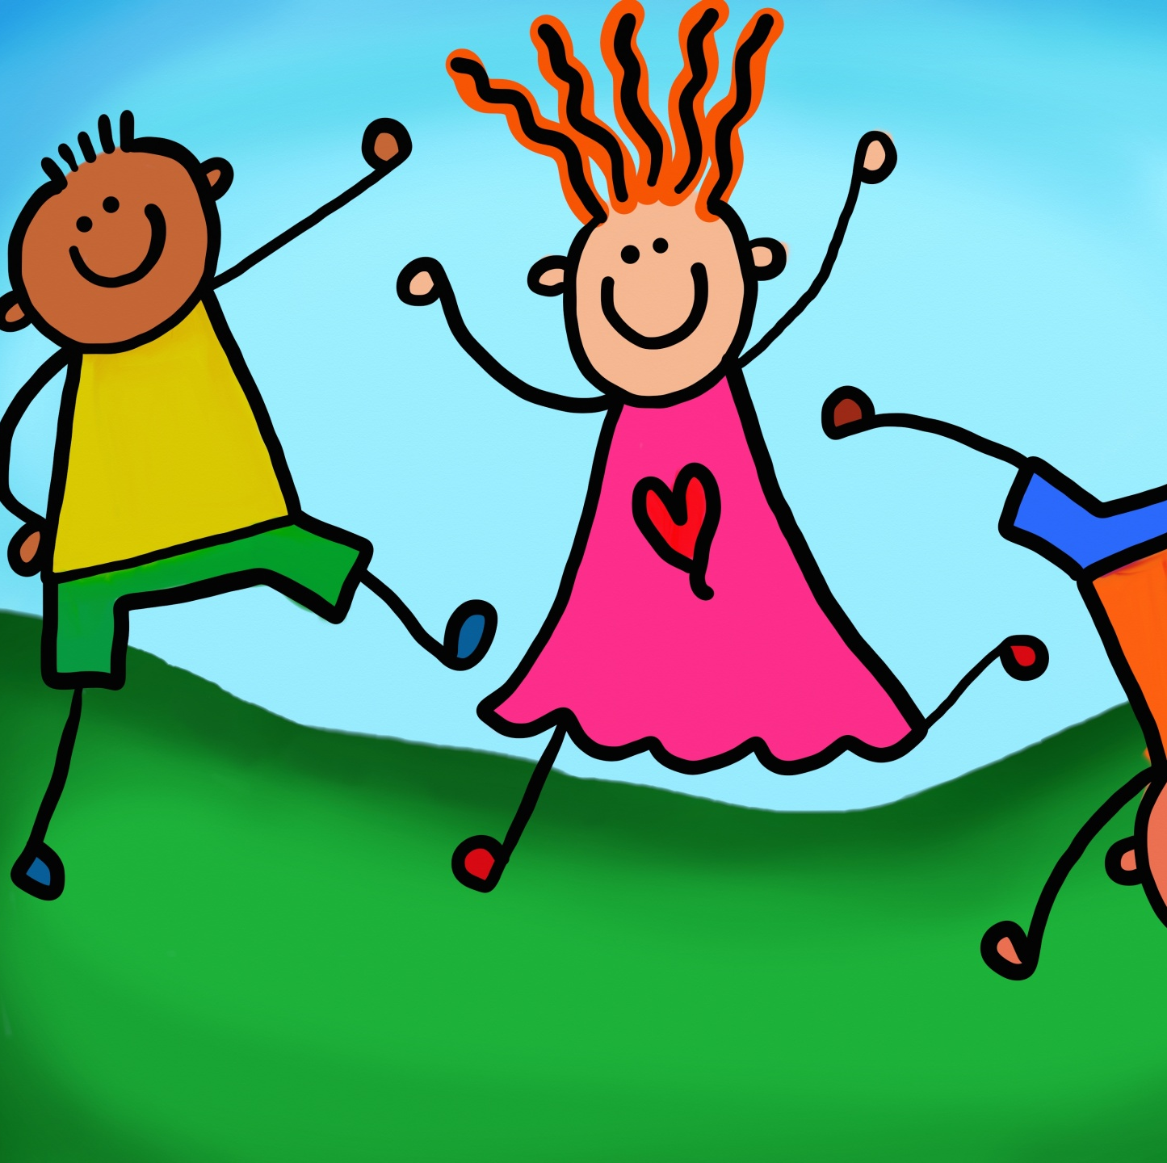
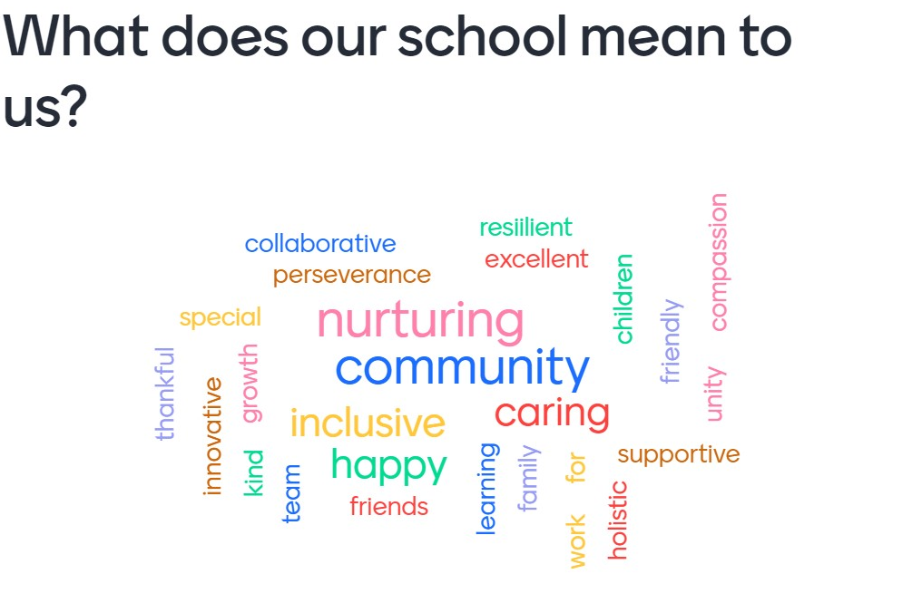
Our Vision and Values
In the Nantlwys Federation we will be 'Learning together and Reaching Higher in Faith'. We will motivate everyone to do their very best and reach their full potential. Our nurture, care and support will ensure everyone will thrive at their own level yet challenged to be their best.
These were the most frequently used words during our vision with our stakeholders: Care, support, valued, community, happy, fair, resilient, ambition and family.
Our values are:
Hope, Wisdom, Community, Perseverance, Trust and Compassion.

Slide 3
Our Values
Our Value | Our Behaviours
Compassion | Everyone within our school community will show compassion. We encourage everyone to show care, kindness, love and respect for one another. We are thankful and demonstrate to pupils the meaning of thankfulness within this value.
Perseverance | We support and encourage everyone to persevere within a positive growth mind set whilst developing resilience.
Trust | As a federation we promote fairness to the whole school communities. We will be honest and open in our communities, and we respect the views and feelings of everyone.
Hope | As a community we encourage the meaning of Hope through developing growth mindset and promoting a positive outlook within our busy lives.
Community | Through being federated schools we are a supportive community who participate in the wider community. Our Diocese and church community is fundamental to our wellbeing and our every day values.
Wisdom | We are all encouraged to try our best and fulfill our potential. We are encouraged to make the right decisions and be positive role models.

Slide 4
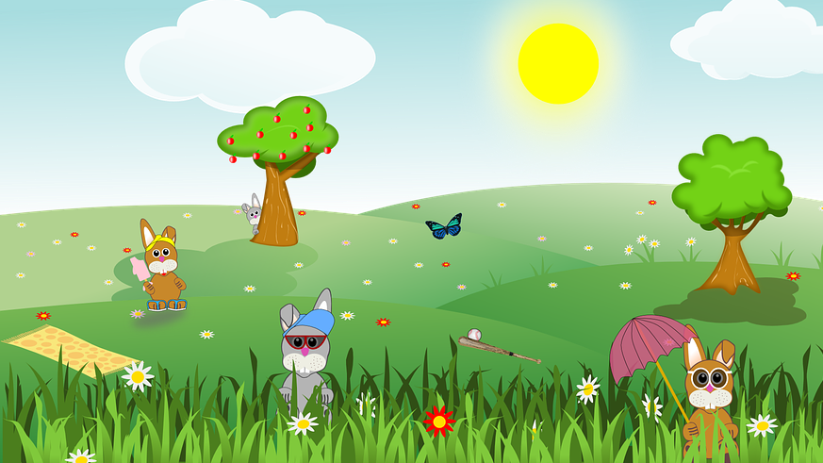
Curriculum Rationale
Digital Learners
Learner Voice
Community involvement
Outdoor learning experiences
Church links
Learners will celebrate their Welsh language, heritage and culture throughout their school life
Learners will be offered Outdoor learning and Forest School
Learners will receive purposeful and meaningful contexts to their learning which will build on Literacy, Numeracy and Digital skills in a fun and engaging curriculum.
Learning will encompass the 4 purposes in exciting ways and teachers will ensure learners have all their individual needs met through a vibrant and fun curriculum.
Learner voice is strong and this goes a long way in our topic planning, learner feedback and progress.
Our school communities work closely with the wider community including Church, School Beat, local playgroups and nurseries and local businesses.
Our topics and themes are built around ‘Cynefin’ Our Local areas and the natural environment, historical and geographical features which surround Nannerch and Nercwys.

Slide 5
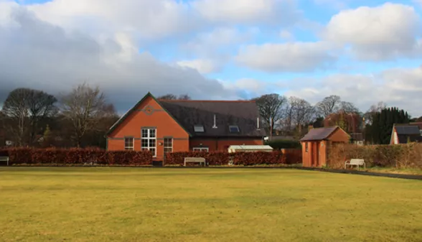
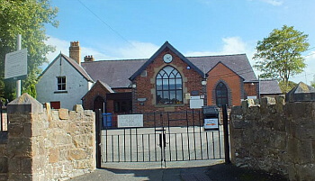
Context
Our small schools are community focused within rural village settings. Both schools encompass the backdrop of the Clwydian Range and are areas of outstanding natural beauty. We have pupils travelling a range of distances from surrounding hamlets, villages and towns. We average on 43 pupils in each school and have pupils accessing school from the age of 3 to 11. Our Nursery includes Early Entitlement pupils. In Nannerch we provide a Wrap Around care in conjunction with the village playgroup and breakfast and after school club. In Nercwys we have a free breakfast club and a paid after-school club, we also have excellent links with the local private nursery. In both schools we have a busy and well planned after school club which caters for all pupils. We have FSM is low, 20 % in Nercwys and 2% in Nannerch and we have identified 8% of pupils with additional learning needs.
Across the federation we teach through the medium of English, however, we are bilingual schools and a significant proportion of the Welsh language is used daily. We celebrate the Welsh culture through Eisteddfod and local and national initiatives.
Learners are taught effectively in mixed age classes making lots of use of our outdoor environments.

Slide 6
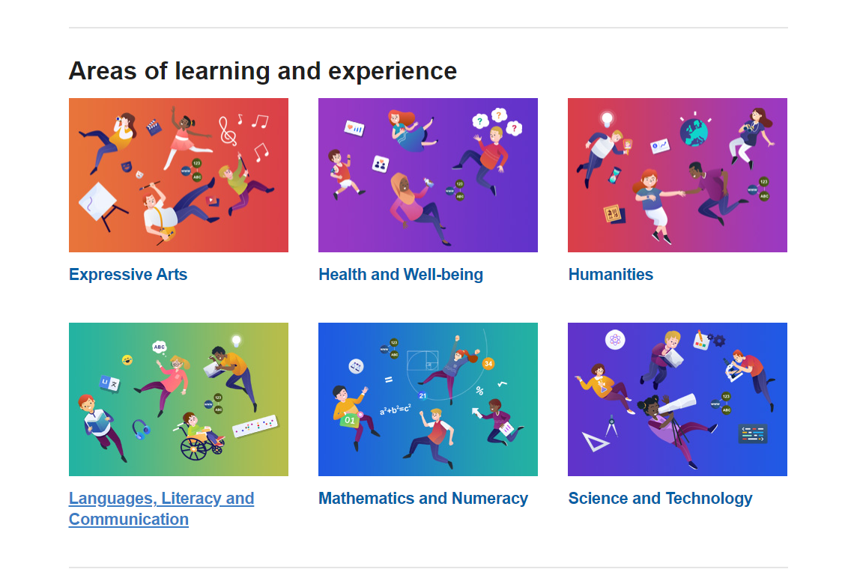
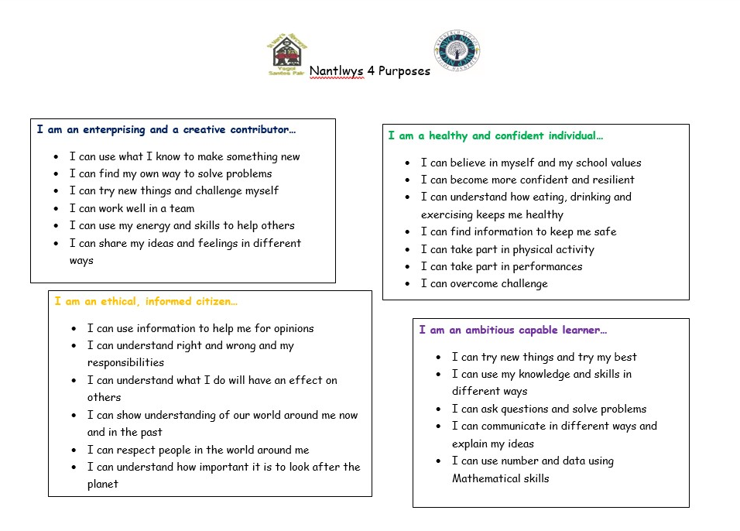
Nantlwys Curriculum
Our curriculum is centered around the 4 purposes which promote happy, confident, healthy, ambitious, ethical and creative learners.
Within the Areas of Learning and experience there are 27 statements of what matter As an example:
Language Connects Us
Teachers when planning will consider the needs, views and stages of learners. Teachers will plan fun, creative, challenging and engaging learning activities which embed the 'Statements of what matters' from the 6 AOLE's.
Learner voice is a major focus in the planning of our cross curricular topics.

